Slide 1

Paper id:176
Cognitive Resonance in Emotional Decoding: A CNN-ResNetB0 Synergy
Vidya P
Computer Science and Engineering
REVA University
Bengaluru, India
R20200579.VIDYAP@cse.reva.edu.in
Sharon Chattopadhyay
Computer Science and Engineering
REVA University
Bengaluru, India
2000069@reva.edu.in
Bhavatarini N
Computer Science and Engineering
REVA University
Bengaluru, India
bhavatarini.n@reva.edu.in
Presenter Name: Vidya P Designation: Student Affiliation: REVA University

Slide 2
Outline
Introduction
Existing Approaches/Related Works
Problems in Existing Approaches
Proposed Methodology
Results and Discussion
Conclusions and Future Work
References

Slide 3
Introduction
Convolutional Neural Networks (CNNs) have revolutionized emotion recognition by using deep learning to automatically interpret facial expressions.
CNNs performs well in recognizing distinct patterns associated with various emotions, enhancing adaptability and accuracy.
Their hierarchical structure enables effective feature extraction, making the proficient in real-time applications across diverse lighting conditions.
CNN-based emotion detection models have extensive effects, spanning human- computer interaction, entertainment, and psychological research.

Slide 4
Existing Approaches/Related Works
The Hosur, V., & Desai, A. R. conducts a survey to provide insights into previous work and developments related to facial emotion recognition.
Network based on convolutional neural network principles, incorporating 909 criteria from Vanilla CNNs and 509 from recent cutting-edge research, surpassing the current standards.
Emotion Detection using Deep Facial Features. 2020 IEEE International Conference on Advent Trends in Multidisciplinary Research and Innovation.
Facial Expression Recognition Using Computer Vision: A Systematic Review by Daniel Canedo
Deep-Emotion: Facial Expression Recognition Using Attentional Convolutional Network.

Slide 5
Problems in Existing Approaches
Data Bias and Generalization: Many datasets used for training models may be biased in terms of gender, ethnicity, age, and cultural diversity.
Lack of Contextual Understanding: Models may not effectively incorporate contextual information, such as the situational or environmental factors that could influence facial expressions.
Limited Expressiveness: Some models may struggle to capture subtle or nuanced facial expressions, limiting their ability to recognize complex emotions accurately.
Interpretable Models: The lack of interpretability in deep learning models can be a challenge.
Emotion Ambiguity: Some facial expressions may be ambiguous and open to interpretation.
Age-related Variations: The effectiveness of models may vary across different age groups.

Slide 6
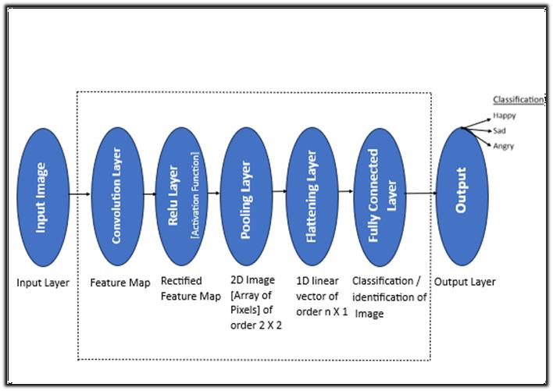

Proposed Methodology
The strategy implemented in the project involves training the CNN model with a variety of images that express emotions.
The primary emotions considered include joy, sadness, anger, Happy. The dataset comprises images of facial expressions corresponding to these emotions, which are fed into the CNN model for training.
The process utilizes integrated data processing modules such as OpenCV, Keras, and Tensor Flow.
Convolutional Neural Network (CNN) comprises several key layers .
Input Image
convolution layer
Relu layer
Pooling layer
Flattening layer Fully connected layer
Output (Happy,sad,angry)

Slide 7
Proposed Methodology
The network employs ReLU activation for non-linearity and concludes with a Softmax Output Layer, efficiently categorizing the input into one of the three emotions.
This streamlined architecture excels in discerning emotional nuances through convolution, activation, and classification stages .
In this model using CNNs, key algorithmic elements include convolutional layers for extracting local features,
fully connected layers for classification, and activation functions like ReLU for introducing non-linearity.
Dropout layers prevent overfitting by randomly deactivating neurons during training.
Cross-entropy is a common loss function measuring the difference between predicted and actual emotion labels.

Slide 8
Proposed Methodology
Optimization algorithms like Adam or SGD update weights to minimize the loss.
Data augmentation techniques, such as rotation and scaling, expand the dataset, preprocessing steps like grayscale conversion and face detection enhance input images.
Incorporated ResNetB0 into our model, leveraging its capacity to train deep neural networks through the utilization of residual connections.
The algorithm learns to map input data to consonanting output labels based on the provided dataset.
Once trained, the CNN can then predict the emotion label of new, unseen facial images.

Slide 9
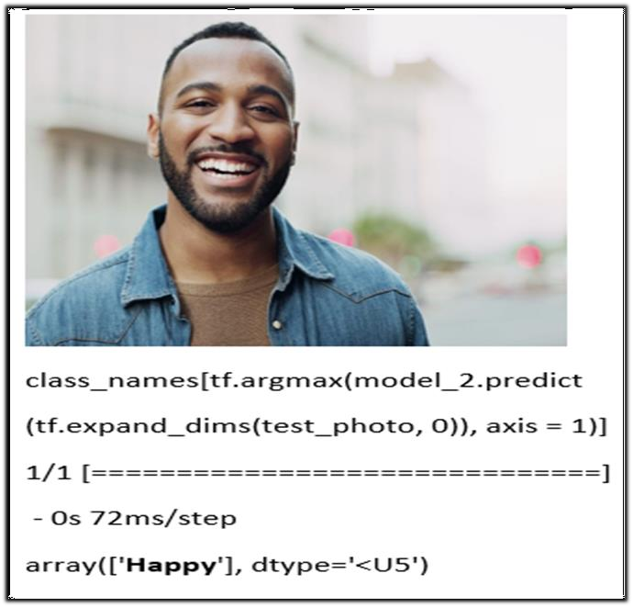

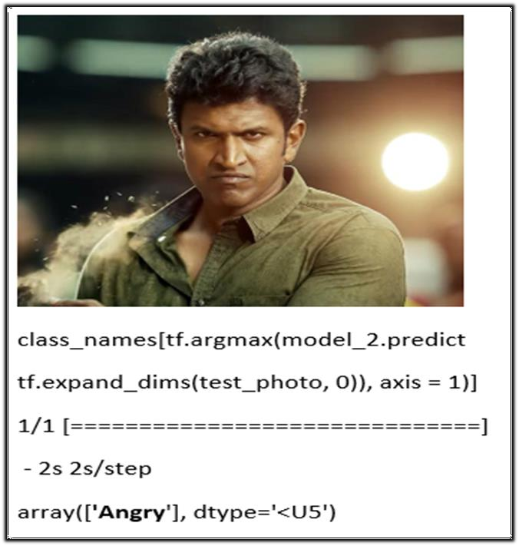

Results and Discussion
The proposed model generates the output with 98% accuracy with input layers of shape [224, 224, 3].
The model demonstrated accurate output generation, correctly identifying happiness as depicted in First figure.
Subsequently, during testing with an image of an angry person, model continued to exhibit precision by accurately predicting the emotion as 'angry’ as depicted in second picture.
This indicates the robustness and reliability of our model in accurately classifying a range of emotions, showcasing its effectiveness across diverse scenarios.

Slide 10
Conclusions and Future Work
The proposed face emotion detection model, utilizes Convolutional Neural Networks (CNNs) and represents a significant step forward in accurately recognizing emotions from facial expressions.
Through extensive experimentation and analysis, we have demonstrated the model's capacity to extract intricate features and effectively classify emotions across diverse individuals and contexts.
Continued research into improving interpretability, addressing privacy concerns, and refining training strategies will contribute to the model's continued success in real-world applications.
Our work underscores the potential of CNN-based emotion recognition systems to enhance human-computer interaction, psychological studies, and various domains requiring emotionally aware technology.

Slide 11
References
1. Hosur, V., & Desai, A. R. (2022). Facial emotion detection using convolutional neural networks. 2022 IEEE 2nd Mysore Sub Section International Conference (MysuruCon). https://doi.org/10.1109/mysurucon55714.2022.9972510Sabrina
2 . Begaj, S., Topal, A. O., & Ali, M. (2020). Emotion Recognition Based on Facial Expressions Using Convolutional Neural Network (CNN).
IEEE Xplore. https://doi.org/10.1109/contesa50436.2020.9302866
3. D Y Liliana: “Emotion Recognition from Facial Expression using Deep Convolutional Neural Network”, IOP Conf. Series: Journal of Physics:
Conf. Series 1193 (2019) 012004, 2019
4. Jaiswal, A., Raju, A. K., & Deb, S. (2020). Facial Emotion Detection using Deep learning. 2020 International Conference for Emerging Technology (INCET).
https://doi.org/10.1109/incet49848.2020.9154121
5. Kondaveeti, H. K., & Goud, M. V. (2020). Emotion Detection using Deep Facial Features. 2020 IEEE International Conference on Advent Trends in Multidisciplinary Research and Innovation (ICATMRI). https://doi.org/10.1109/icatmri51801.2020.9398439

Slide 12
6. Jaiswal, S., & Nandi, G. C. (2019). Robust real-time emotion detection system using CNN architecture. Neural Computing and Applications, 32(15), 11253–11262. https://doi.org/10.1007/s00521-019-04564-4
7. Baffour, P. A., Nunoo‐Mensah, H., Keelson, E., & Kommey, B. (2022). A survey on deep learning algorithms in facial Emotion Detection and Recognition. Jurnal Inform, 7(1), 24 – 32. https://doi.org/10.25139/inform.v7i1.4563
8 .Saxena, A., Khanna, A., & Gupta, D. (2020). Emotion Recognition and Detection Methods: A Comprehensive survey. Journal of Artificial Intelligence and Systems, 2(1), 53–79. https://doi.org/10.33969/ais.2020.21005
9 . Forhad Ali, Md., Khatun, M., & Aman Turzo, N. (2020). Facial Emotion Detection Using Neural Network. International Journal of Scientific & Engineering Research, Volume 11(Issue 8), ISSN 2229- 5518. https://www.researchgate.net/publication/344331972
10.Mehendale, N. (2020). Facial emotion recognition using convolutional neural networks (FERC). SN Applied Sciences. 11. Bhavatarini, N., Syed Muzamil Basha, and Syed Thouheed Ahmed. Deep Learning: Practical approach. MileStone Research Publications, 2022.

Slide 13

Thank You

